Slide 1
Course introduction
The Project Work course is near connected to the
Power or Software project you all is enrolled
Steffen Skov
Ass. Professor
Electronic engineer from Aalborg University
Master in Industrial IT

Slide 2
Student load
XI-PRW Project Work
5 ECTS ~ 125 hours of students load
12 Lessons: 40 h
Portfolio 20 h
Left for reading, preparation and exam 65 h

Slide 3
Course goals
Describe The Engineering Education Model of Southern University of Southern Denmark (EEM)
Present his achieved personal competences and himself as a project group member
Prepare an oral presentation and do the presentation
Compile a project foundation, a time schedule and requirement specification
Account for the structure of a written report
Manage “conflict” in a project group
Explain creation of the problem statement and aim formulation
Describe tools to manage a study project using a process model
Set up individual learning goals and reflect about result achieve by self study or mutual teaching in the group

Slide 4
Portfolio
Students must maintain his own personal portfolio during the course
The portfolio will be assessed in the end of the course and currently by your project supervisor
The portfolio must contain these artefacts in the end:
A description of your experience with project work before this course (I)
Felder test with your comments (I)
Belbin - profil with your personal opinion/reflection (I/G)
Learning contact (I)
Group foundation (G)
Project formulation (G)
Vision and plan for the project (G)
Example of presentation incl. the Power Point (or similar) and your preparation (I/G)
Process document for your project (I/G)

Slide 5
Learning material
A course schedule
Portfolio artefacts
Slides
Literature link
Lecture notes
.........
Let take a look at Blackboard

Slide 6
Assessment
Oral examination
5 – 6 in advanced known questions/subject
Examples:
PBL and learning styles as it is implemented in EEM
Team roles and your experience with them in the project
How to form a group and write the problem statement
.....
The portfolio is the basic of the exam and has to be approve before the oral exam. Examples:
A description of your experience with project work before this course
Felder test with your comments
Belbin-profile with your personal opinion
Learning contact
Group foundation
Project formulation

Slide 7


Project Learning envirioment
Subjects
Subjects
PRW
course
Subjects
Subjects
PRW
teacher
Team &
General skills
Professional
skills
What can I learn?
Supervisor
Communicating
Mission & results
Pratice PRW skills
Supervisor monitor the progress of the group
Portfolio
cases
Cooperation
PSE1
project
Document skills
And reflection
Project
group
Portfolio
S
EEM
Assess
Basic
of exam
S
G
P

Slide 8
The Schedule of this course
Presentation of

Slide 9
The Engineering Education Model of the University of Southern Denmark (EEM)
Presentation

Slide 10
History
Before 1997 the curriculum focus had a technical subject oriented view with some content of PBL
1997 – first real approach towards implementing full scale PBL
Each semester had a semester project to tie up the different technical subjects associated with the semester, but because the project load increased, the technical subjects taught had to decrease → Student autonomy/responsibility
2002 – Odense Model
The main focus where on
Competencies with the technical subjects applicable within the field of study
Personal competencies – how to act in cooperation with others in the process of learning.
How to learn – students individual learning styles
2006 – The Engineering Education Model of the SDU (EEM)
As a result of the merger between IOT and SDU
Through a project based and holistic approach, EEM focuses on the development of the students’ academic, personal and learning competences
Students educated according to EEM are characterized by being internationally orientated, creative, innovative and interdisciplinary as well as business oriented.

Slide 11
The Engineering Education Model of the University of Southern Denmark (EEM)
The student will interact with the three elements.
Subject: Study activities in delimited courses of study
Project: Interdesciplinary and application-oriented problems in a project context
Team: Group of fellow students with whom the student participates in a study-related context
Subject
3
A
1
Student
C
B
Team
Project
2

Slide 12
Group exercise
Discuss the values described in EEM
For 30 minutes
Find the 5 most important expressions from the EEM paper

Slide 13
Problem Based Learning
What is?

Slide 14
PBL means
Use the problem (idea, issue, user needs, )to drive the student learning on a need to know basis
Problem based – maybe not in the very broad sense, it should of course be within your field of engineering!
Make you a self-contained learner
Select what you already know that pertains to the engineering field in question
Identify what you need to know in addition
Learn it (and teach it to others)
Apply new and already known knowledge to solve the problem
Interdependent (not independent!) – depend on each other – teach each other

Slide 15
PBL
Self assessed ( during the project process)
Supervisor monitor your progress
Outcome: Learning engineering subjects, lifelong learning skills, team working skills.

Slide 16
PBL map
Problem- oriented
Student directed
Discipline projects
Problem projects
Project-organised
Case-based
Classroom Lecturing
Overview Lectures
Teacher directed
”Closed” Problems
Open
Problems

Slide 17
Learning Style
We are all different in our

Slide 18
Different models
Kolb, experiential learning
Dunn, Building Excellence
Felder, Learning styles and strategies

Slide 19
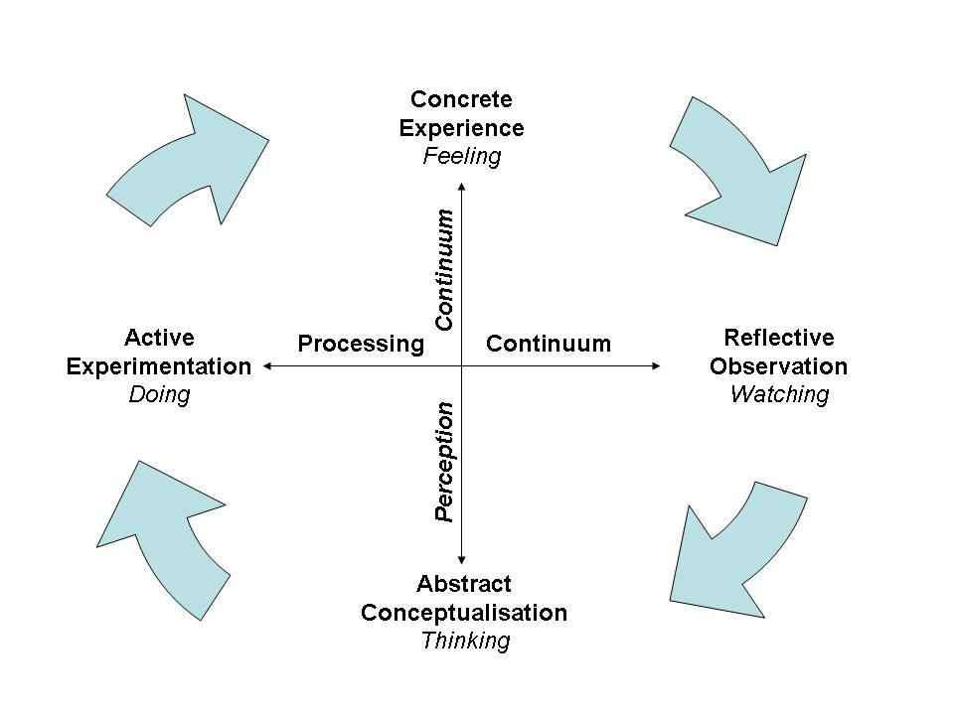
Kolb

Slide 20
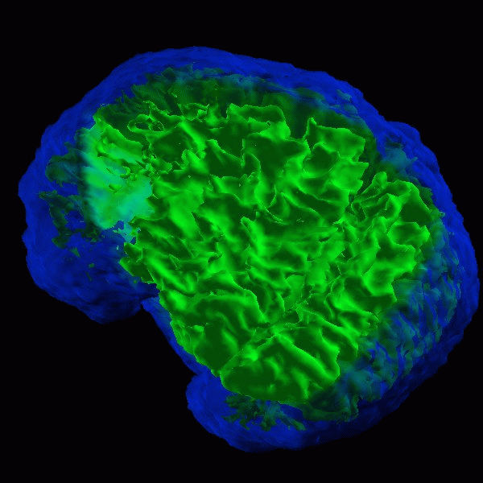
Dunn
BUILDING EXCELLENCE…The Learning Individual® Self-Awareness — “Know Thyself”
If learning is fundamental to everything we do, then understanding one’s unique learning style is fundamental to learning.

Slide 21
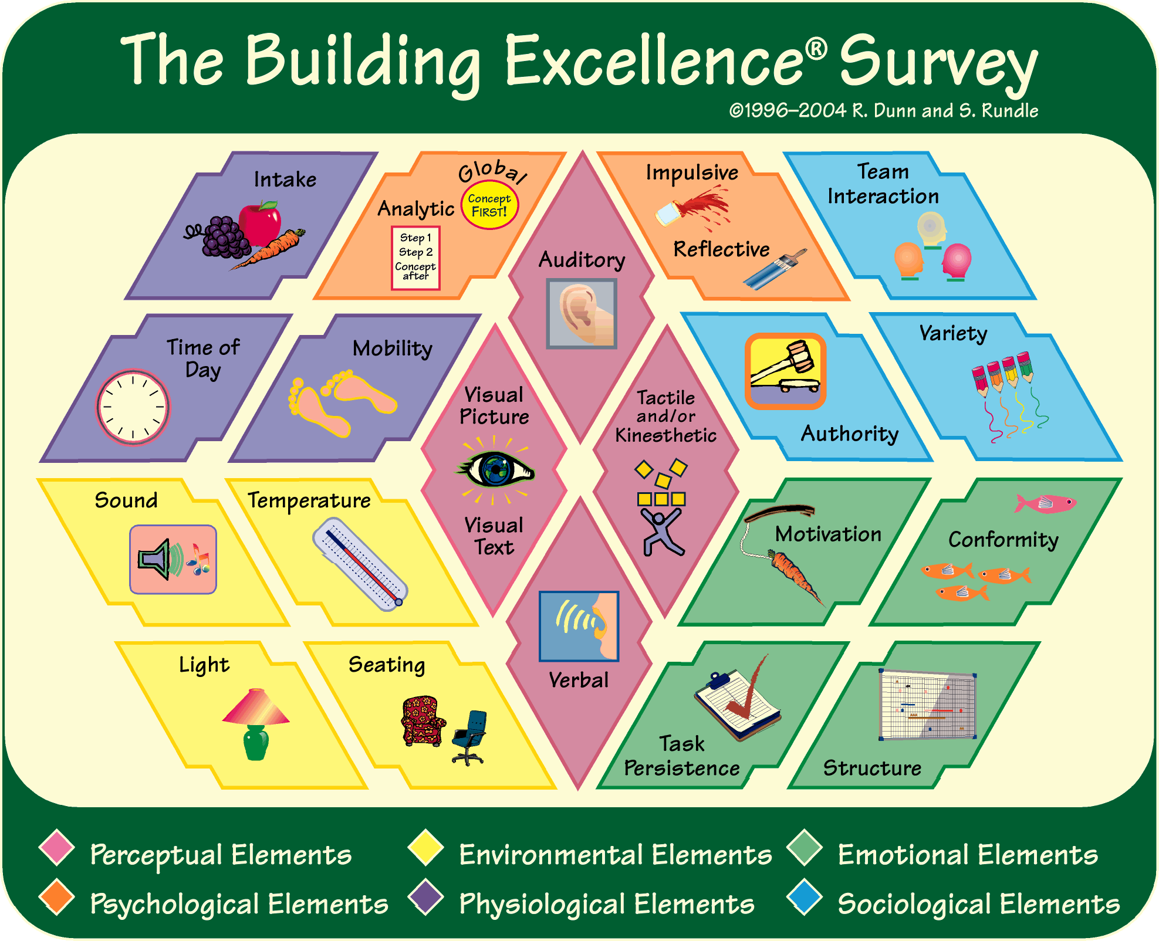
Dunn, Building Excellence

Slide 22
Felder - ILS – learning styles
ACTIVE ←→ REFLECTIVE
SENSING ← → INTUITIVE
VISUAL ← → VERBAL
SEQUENTIAL ← → GLOBAL

Slide 23
Felder - ILS – learning styles
 | My score
Active | 11 9 7 5 3 1 1 3 5 7 9 11 | Reflective
Sensing | 11 9 7 5 3 1 1 3 5 7 9 11 | Intuitive
Visual | 11 9 7 5 3 1 1 3 5 7 9 11 | Verbal
Sequential | 11 9 7 5 3 1 1 3 5 7 9 11 | Global

Slide 24
ACTIVE AND REFLECTIVE LEARNERS
Active learners tend to retain and understand information best by doing something active with it--discussing or applying it or explaining it to others. Reflective learners prefer to think about it quietly first.
"Let's try it out and see how it works" is an active learner's phrase; "Let's think it through first" is the reflective learner's response.
Active learners tend to like group work more than reflective learners, who prefer working alone.
Sitting through lectures without getting to do anything physical but take notes is hard for both learning types, but particularly hard for active learners.

Slide 25
SENSING AND INTUITIVE LEARNERS
Sensing learners tend to like learning facts, intuitive learners often prefer discovering possibilities and relationships.
Sensors often like solving problems by well-established methods and dislike complications and surprises; intuitors like innovation and dislike repetition. Sensors are more likely than intuitors to resent being tested on material that has not been explicitly covered in class.
Sensors tend to be patient with details and good at memorizing facts and doing hands-on (laboratory) work; intuitors may be better at grasping new concepts and are often more comfortable than sensors with abstractions and mathematical formulations.
Sensors tend to be more practical and careful than intuitors; intuitors tend to work faster and to be more innovative than sensors.
Sensors don't like courses that have no apparent connection to the real world; intuitors don't like "plug-and-chug" courses that involve a lot of memorization and routine calculations.

Slide 26
VISUAL AND VERBAL LEARNERS
Visual learners remember best what they see--pictures, diagrams, flow charts, time lines, films, and demonstrations. Verbal learners get more out of words--written and spoken explanations. Everyone learns more when information is presented both visually and verbally.
In most college classes very little visual information is presented: students mainly listen to lectures and read material written on chalkboards and in textbooks and handouts. Unfortunately, most people are visual learners, which means that most students do not get nearly as much as they would if more visual presentation were used in class. Good learners are capable of processing information presented either visually or verbally.

Slide 27
SEQUENTIAL AND GLOBAL LEARNERS
Sequential learners tend to gain understanding in linear steps, with each step following logically from the previous one. Global learners tend to learn in large jumps, absorbing material almost randomly without seeing connections, and then suddenly "getting it."
Sequential learners tend to follow logical stepwise paths in finding solutions; global learners may be able to solve complex problems quickly or put things together in novel ways once they have grasped the big picture, but they may have difficulty explaining how they did it.

Slide 28
Felder - ILS – learning styles
Have a look here: http://www4.ncsu.edu/unity/lockers/users/f/felder/public/ILSpage.html
Take a test on-line: http://www.engr.ncsu.edu/learningstyles/ilsweb.html
An explanation could be found here: http://www4.ncsu.edu/unity/lockers/users/f/felder/public/ILSdir/styles.htm

Slide 29
Team roles
Introduction to Belbin

Slide 30
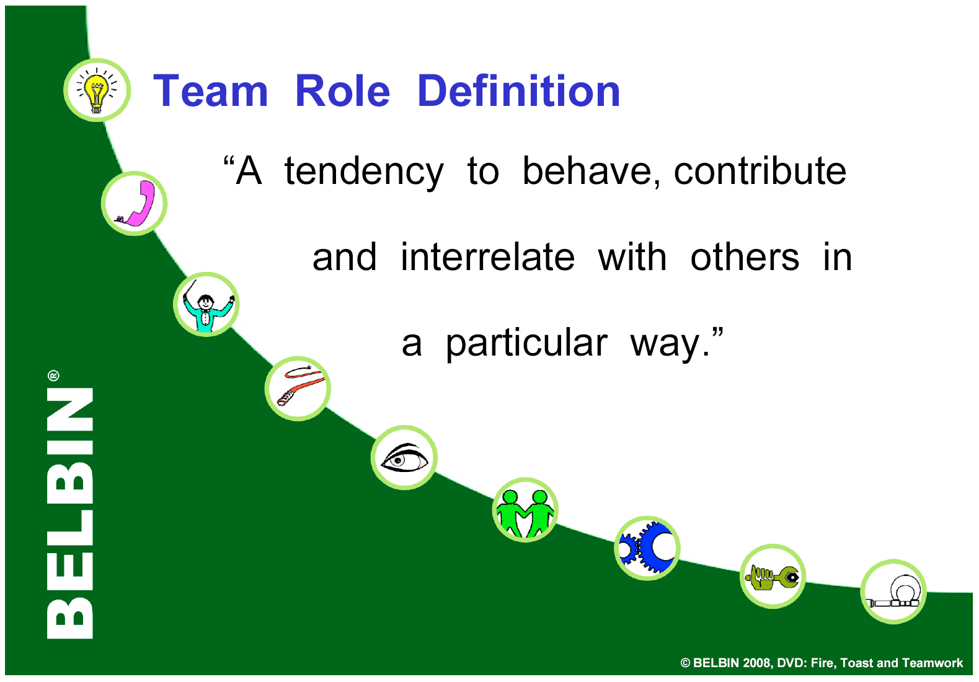

Slide 31

What underlies team-role behaviour?
PERSONALITY
ROLE
LEARNING
MENTAL
ABILITIES
BEHAVIOUR
EXPERIENCE
CURRENT VALUES
AND MOTIVATIONS
FIELD
CONSTRAINTS

Slide 32









Team Roles and Descriptions
Team-Role Contribution Allowable Weaknesses
PLANT (PL)
Creative, Solves difficult problems Loses touch with everyday realities
RESOURCE INVESTIGATOR (RI)
Enterprising, Quick to explore opportunities Weak in follow through
CO-ORDINATOR (CO)
Makes good use of group activities Manipulative
SHAPER (SH)
Thrusting and challenging Provocative, Aggressive
MONITOR EVALUATOR (ME)
Discerning and Objective Uninspiring, Sceptical
TEAMWORKER (TW)
Co-operative, Averts friction Indecisive
IMPLEMENTER (IMP)
Organised, Efficient, Practical Slow to see new possibilities
COMPLETER FINISHER (CF)
Painstaking, Conscientious Anxious, Reluctant to delegate
SPECIALIST (SP)
Single-minded, Professionally dedicated Limited in Interests

